Slide 1
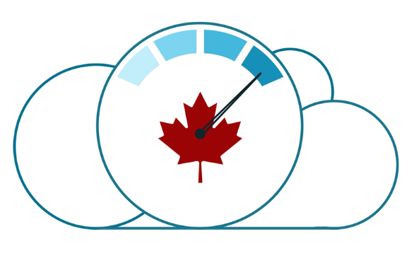
Prowler Extensions – GC Accelerators AWS Guardrails
Overview of guardrail verifications for AWS
January 9th, 2020 Cloud Technical Working Group

Slide 2
Background
How to access cloud services qualified to host Protected B data were presented at the GC Enterprise Architecture Review Board (GC EARB) on September 19th, 2019
As part of that presentation, a set of mandatory, minimum, guardrails that departments must meet were presented
These guardrails are monitored by SSC Cloud Brokering Service and must be met within 30 days of your account being provisioned
The GC cloud community has been working to create automation to reduce the friction of becoming and verifying compliance

Slide 3


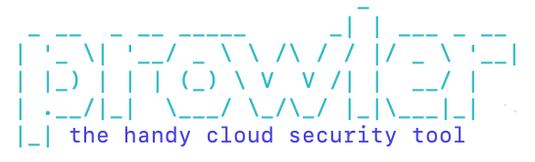

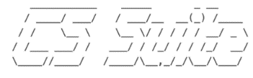
Healthy Ecosystem of Security Compliance Tools
AWS Security Hub
Pros:
Open source
Covers a number of compliance verticals
Easy to extend
Simple architecture
AWS Config
ScoutSuite
Prowler
Cons:
Written in bash (MacOSX, Linux, Win10)
No fancy dashboards
Cloud Custodian
CS Suite

Slide 4
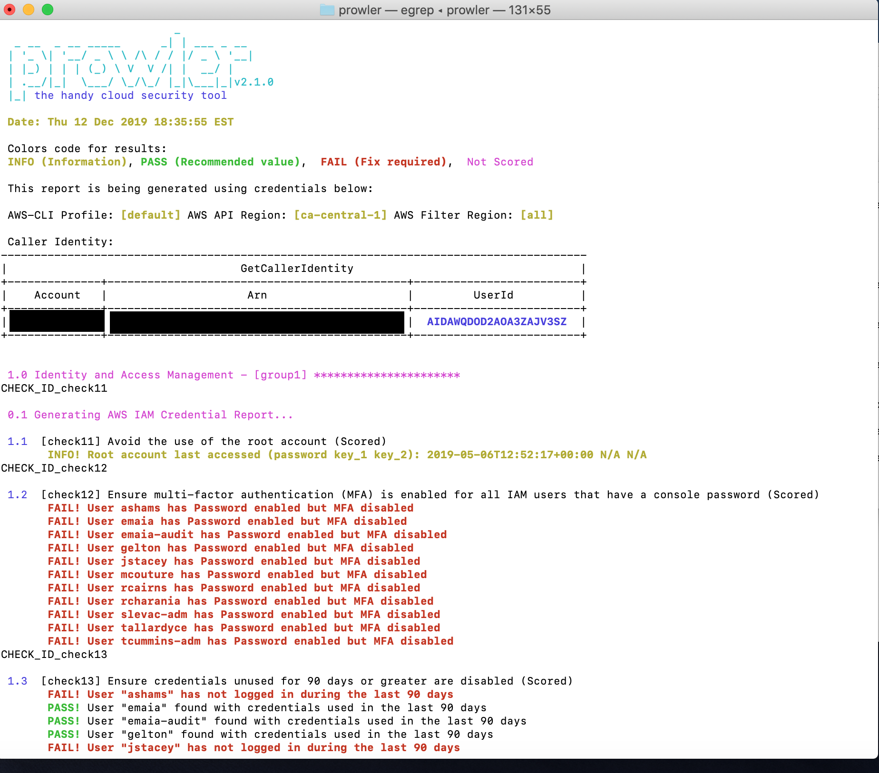
What Is Prowler?
Based on CIS Benchmark and other compliance verticals
Confirms the configuration of services and resources
Scans a single account (although multi-account capabilities exist)
Simple text and CSV output providing a simple pass/fail
Can be integrated into AWS Security Hub

Slide 5


GC Guardrails Extensions
GC Accelerator (AWS Guardrails Extensions for Prowler)
$ ./prowler –g gc
/prowler
check11
/checks
check12
…
check_extragc61
group1_iam
/groups
…
group14_gc
https://github.com/canada-ca/cloud-guardrails-aws/tree/master/tools

Slide 6
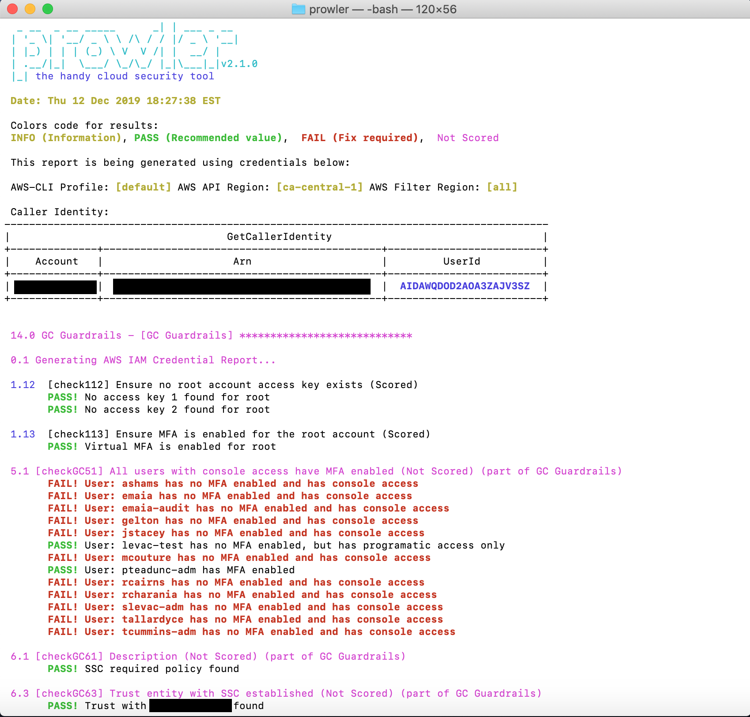
GC Accelerator - Prowler with GC Guardrails Extensions for AWS
A Government of Canada group has been created
Reuses some existing checks (about 40-50% coverage)
New checks added that are specific to the GC Guardrails
Thanks to the SSC Cloud Brokering team for sharing their procedures for manual verification
Demo

Slide 7
Challenges
A landing zone (or GC Accelerators) deploys a multi-account structure. Some verifications allow configuration in one account, but not other. There is no way to distinguish account types. Example: IGWs are allowed in the perimeter account. Security account is the master account for GuardDuty
Tagging of accounts to distinguish them is one possible way to address this.
Private Marketplace CLI documentation stinks (yup, sorry, it really does).
Are root account identifiers considered a secret or can they be included in code?
We need a department’s real environment to test this one instead of our sandbox.

Slide 8
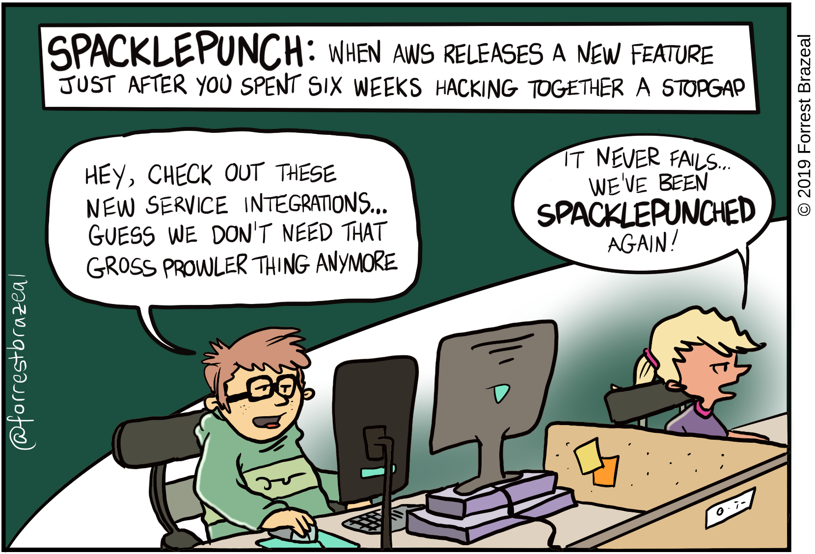
Roadmap
Tagging for multi-account structures
Multi-account verification. There are capabilities within Prowler. They need to be explored
Add SCPs and config rules to repo to help departments achieve required configurations
Integrate Prowler with AWS Security Hub
Move away from Prowler by going cloud native by using lambda. (long-term)

